Slide 1
Employee Data Analysis using Excel
STUDENT NAME: Keerthi Mathi
REGISTER NO:122204085/asunm1659122204085
DEPARTMENT:B.COM corporate secretary ship
COLLEGE : Shri krishnaswamy college for women

Slide 2
PROJECT TITLE
Employee Performance Analysis using Excel

Slide 3


AGENDA
Problem Statement
Project Overview
End Users
Our Solution and Proposition
Dataset Description
Modelling Approach
Results and Discussion
Conclusion
3/21/2024 Annual Review

Slide 4

PROBLEM STATEMENT
The current employee database of the company is inefficient, leading to various operational challenges, including poor data accuracy, limited access to employee information, and security concerns. HR personnel face difficulty in retrieving, updating, and managing employee data, which results in delays in decision-making and compliance issues. Additionally, the lack of integration with other HR systems like payroll and performance management creates data silos, further complicating processes.

Slide 5

PROJECT OVERVIEW
Analyzing employee performance based on various factors involves a structured approach to evaluate their achievements, ratings, and patterns across different categories like high, medium, or low performers.

Slide 6

WHO ARE THE END USERS?
Employees
HR Personnel
Managers/Supervisors
Payroll Department
IT/Admin Staff
Manager

Slide 7

OUR SOLUTION AND ITS VALUE PROPOSITIO
Conditional Formatting- Missing
Filter- Remove
Formula – Performance
Pivot-Summary
Graph-Data visualiztion

Slide 8
Dataset Description
Employee- kaggle
26 features
9-features
Employee ID – number
Name-text
Employee type
Proformance level
Gender- Male, Female
Employee rating-number

Slide 9

THE "WOW" IN OUR SOLUTION
Comprehensive Insights:
By analyzing demographic factors like gender, location, and academic qualifications, we provide a 360-degree view of workforce dynamics.
Data-Driven Decisions:
With our detailed visualizations and clear conclusions, leadership can make informed decisions about talent acquisition, diversity initiatives, and regional investments, giving your company a competitive edge.
Advanced Segmentation:
Whether it’s filtering by qualifications (Bachelors, Masters, PhDs) or looking at gender disparities across locations, our tool allows for detailed segmentation, enabling more accurate workforce planning and forecasting.
3/21/2024 Annual Review
9

Slide 10
MODELLING
DATA COLLECTION
1 Kaggle
2selecting data
3Grouping up in Excal Sheet
FATURE COLLECTION
1Employ name
2Empolyee ID
3 Gender
PROFORMANCE LEVEL
1Exceptional Performance
2Above Average Performance
3Benchmark Performance
10

Slide 11
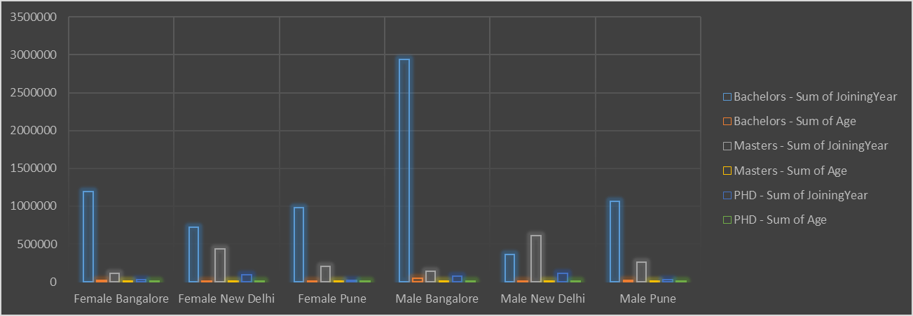
RESULTS
11

Slide 12
conclusion
From the analysis, it is clear that both male and female populations are distributed unevenly across cities like Bangalore, New Delhi, and Pune. Bangalore has the highest number of individuals across all categories, with a significant portion holding Bachelors and Masters degrees. For both genders, Bangalore stands out as a hub for education and skilled professionals, particularly for male Bachelors degree holders.
Pune and New Delhi show relatively lower but consistent numbers in higher education qualifications. These findings indicate a strong concentration of educated professionals in urban centers , with noticeable gender variations in academic qualifications and locations.
Notes:
From the analysis, it is clear that both male and female populations are distributed unevenly across cities like Bangalore, New Delhi, and Pune. Bangalore has the highest number of individuals across all categories, with a significant portion holding Bachelors and Masters degrees. For both genders, Bangalore stands out as a hub for education and skilled professionals, particularly for male Bachelors degree holders.Pune and New Delhi show relatively lower but consistent numbers in higher education qualifications. These findings indicate a strong concentration of educated professionals in urban centers, with noticeable gender variations in academic qualifications and locatio

